Slide 1
ANTENNA WAVE PROPAGATION
P.RAJESH
Assistant Professor(Adhoc)
DEPT OF E.C.E
JNTUA CE Anantapur

Slide 2
CONTENTS ..
UNIT I
Antenna Basics
Thin Linear Wire Antennas
UNIT II
VHF, UHF AND Microwave Antennas - I
UNIT III
VHF, UHF AND Microwave Antennas – II
Lens Antennas
UNIT IV
Antenna Arrays
UNIT V
Wave Propagation – I
Wave Propagation - II

Slide 3
UNIT I
Antenna Basics: Basic Antenna Parameters - Patterns, Beam Area, Radiation Intensity, Beam Efficiency, Directivty-Gain-Resolution, Antenna Apertures, Effective Height. Related Problems.
Thin Linear Wire Antennas: Radiation from Small Electric Dipole, Quarter wave Monopole and Halfwave Dipole - Current Distributions, Field Components, Radiated Power, Radiation Resistance, Beam widths, Directivity, Effective Area and Effective Height. Natural current distributions, fields and patterns of Thin Linear Center-fed Antennas of Different Lengths, Illustrative Problems.
Loop Antennas - Introduction, Small Loop, Comparison of Far Fields of Small Loop and Short Dipole, Radiation Resistances and Directivities of Small and Large Loops (Qualitative Treatment).

Slide 4
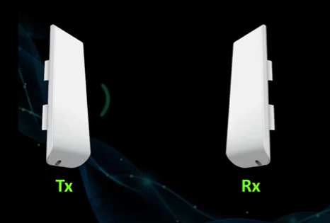
Basic Concepts of Antenna
i) Generation of EM Waves
Electromagnetic Waves are important part of Antenna

Slide 5
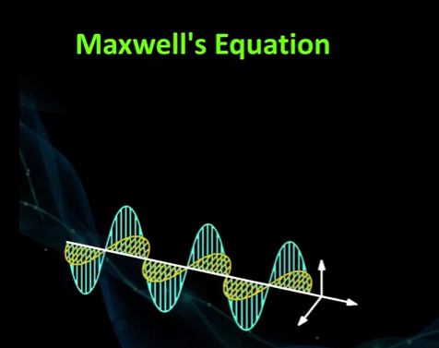
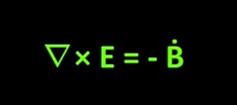
EM Waves are studied with the help of Maxwell’s Equations
EM Eaves are generated with help of changing Electric and magnetic filed
Eq: - i) the change in magnetic filed is required for generation of electric field

Slide 6
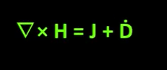
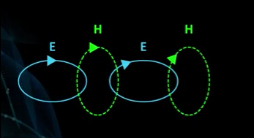
Eq: - 2) the change in electric filed is required for generation of magnetic field
With combination of both Eq:1 & Eq: 2)
the electric field and magnetic field are generated with the help of each other and perpendicular to each other so they are transverse in nature in which electric and magnetic field have different phases for propagation.

Slide 7
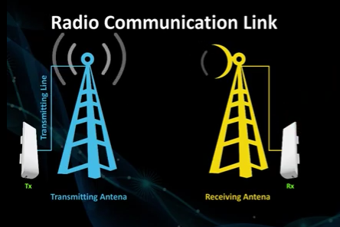
Radio communication link
Transmitting Antenna : The signal from Transmitter goes to the Tx-Antenna using link by Transmitting line
Receiving Antenna : The signal from Tx-Antenna is received at the Rx-Antenna and by using link to Receiver .
The EM Wave generated is a Planer EMF which is 2D where the planar EMW is moved from Tx-Antenna to the Rx-Antenna where the Rx-antenna converts EMW in to form of Current.

Slide 8
What is an Antenna ?
Antenna is a device which helps in transmission or reception of signal.
Antenna as a Transducer between guided wave and space wave.
Antenna as a sensor
Antenna be as Impedance matching device

Slide 9
An antenna (or aerial) is an electrical device which converts electric power into radio waves, and vice versa.
It is usually used with a radio transmitter or radio receiver.
In transmission, a radio transmitter supplies an oscillating radio frequency electric current to the antenna's terminals, and the antenna radiates the energy from the current as electromagnetic waves (radio waves).
In reception, an antenna intercepts some of the power of an electromagnetic wave in order to produce a tiny voltage at its terminals, that is applied to a receiver to be amplified.
Antennas are essential components of all equipment that uses radio. They are used in systems such as radio broadcasting, broadcast television, two-way radio, communications receivers, radar, cell phones, and satellite communications, as well as other devices such as garage door openers, wireless microphones, bluetooth enabled devices, wireless computer networks, baby monitors, and RFID tags on merchandise.

Slide 10
Typically an antenna consists of an arrangement of metallic conductors ("elements"), electrically connected (often through a transmission line) to the receiver or transmitter.
• Antenna name is borrowed from zoology, in which the Latin word antennae is used to describe the long, thin feelers possessed by many insects.
• In wireless communication systems, signals are radiated in space as an electromagnetic wave by using a receiving transmitting antenna and a fraction of this radiated power is intercepted by using a receiving antenna.
• a rigid metallic structure is called an "antenna" while the wire form is called an "aerial"

Slide 11
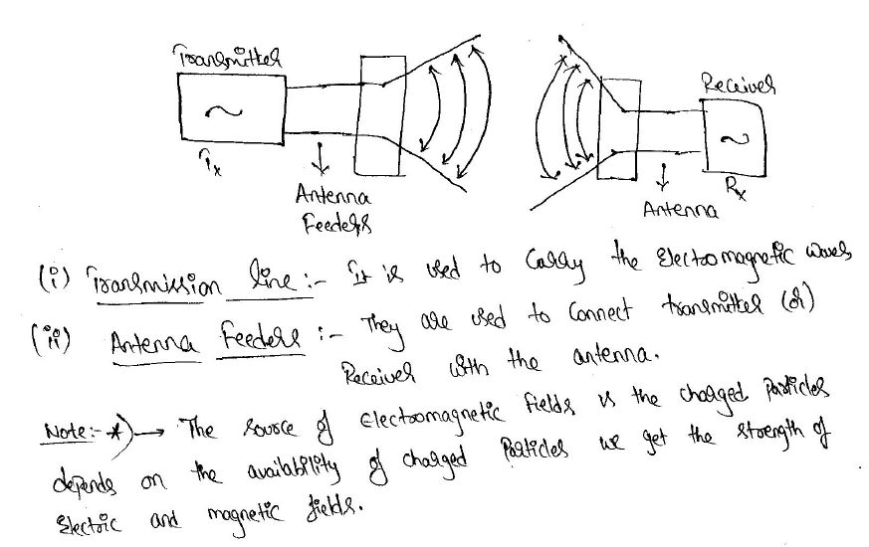

Slide 12
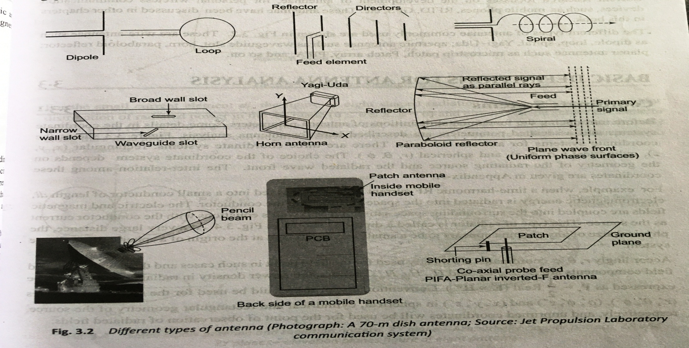
Types of Antennas:

Slide 13
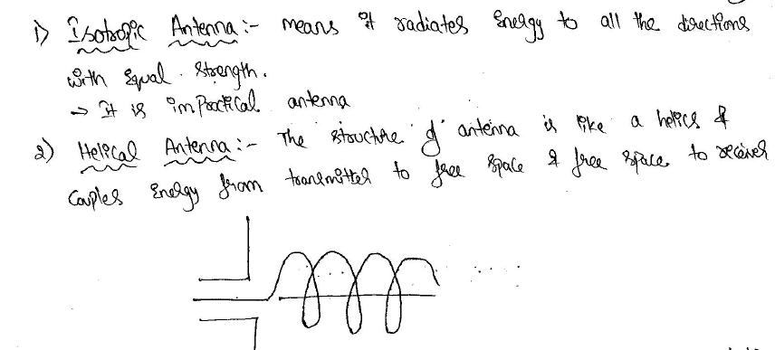

Slide 14
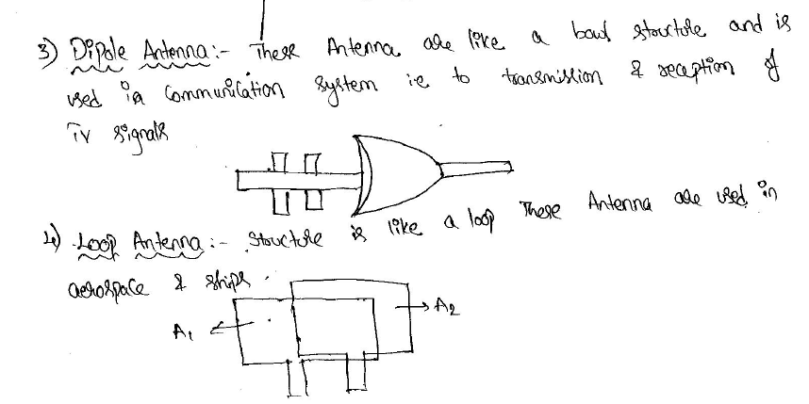

Slide 15
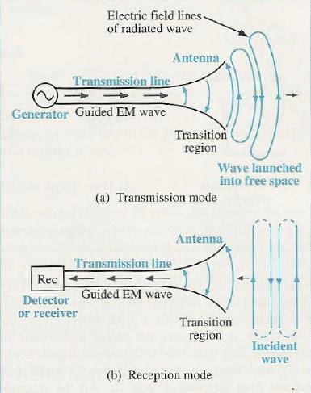
5. Two Wire Antenna :

Slide 16
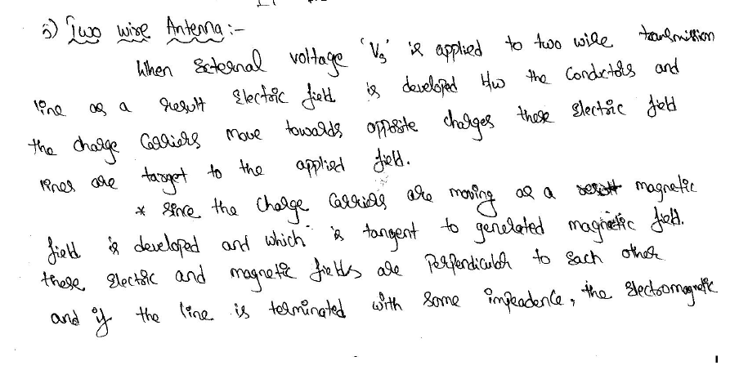

Slide 17
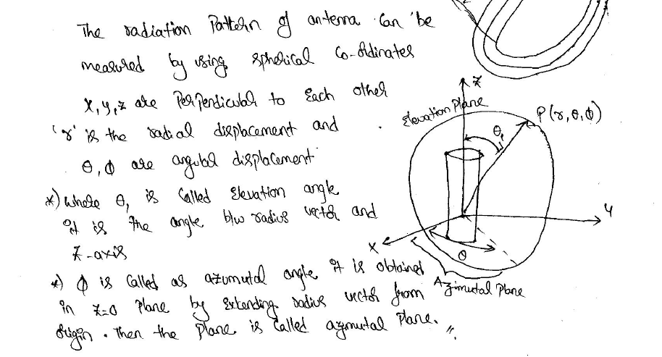

Slide 18
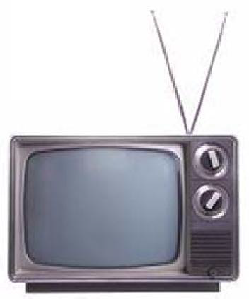
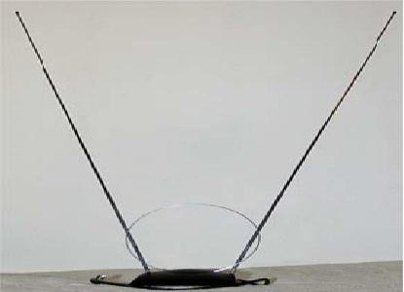
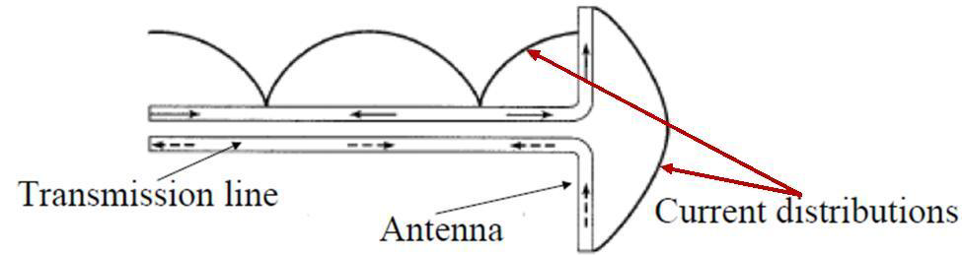
6. Wire antennas: dipole, monopole, loop antenna, helix
Usually used in personal applications, automobiles, buildings, ships, aircrafts and spacecrafts.

Slide 19
7. Aperture antennas:
horn antennas, waveguide opening
Usually used in aircrafts and space crafts, because these antennas can be flush-mounted

Slide 20
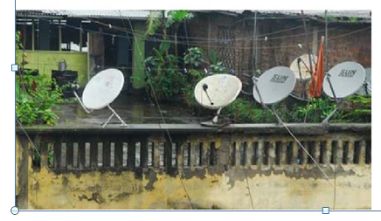
8. Reflector antennas:
parabolic reflectors, corner reflectors
These are high gain antennas usually used in radio astronomy, microwave communication and satellite tracking.

Slide 21
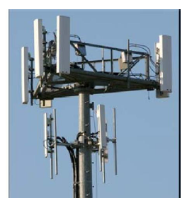
9. Lens antennas:
convex-plane, co vex-convex , convex-concave and concave-plane lenses These antennas are usually used for very high frequency applications.
10. Microstrip antennas:
rectangular, circular etc. shaped metallic patch above a ground plane Used in aircraft, spacecraft, satellites, missiles, cars, mobile phones etc.

Slide 22
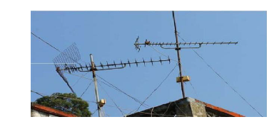
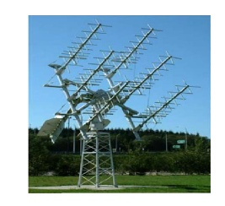
11. Array antennas
o Yagi-Uda antenna, microstrip patch array, aperture array, slotted waveguide array.
o Used for very high gain applications with added advantage, such as, controllable radiation pattern.

Slide 23
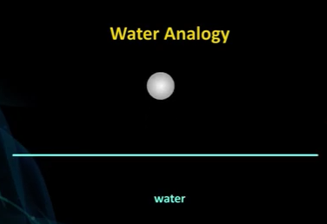
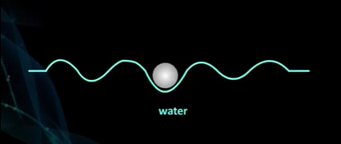

Slide 24
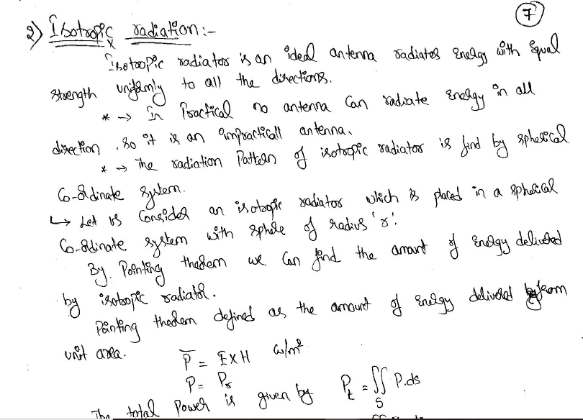

Slide 25
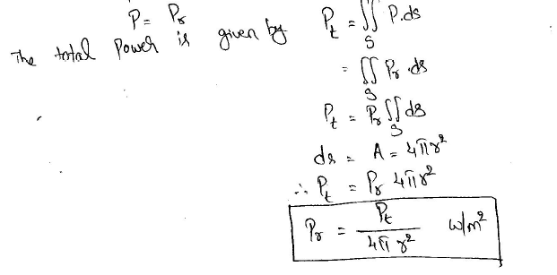

Slide 26
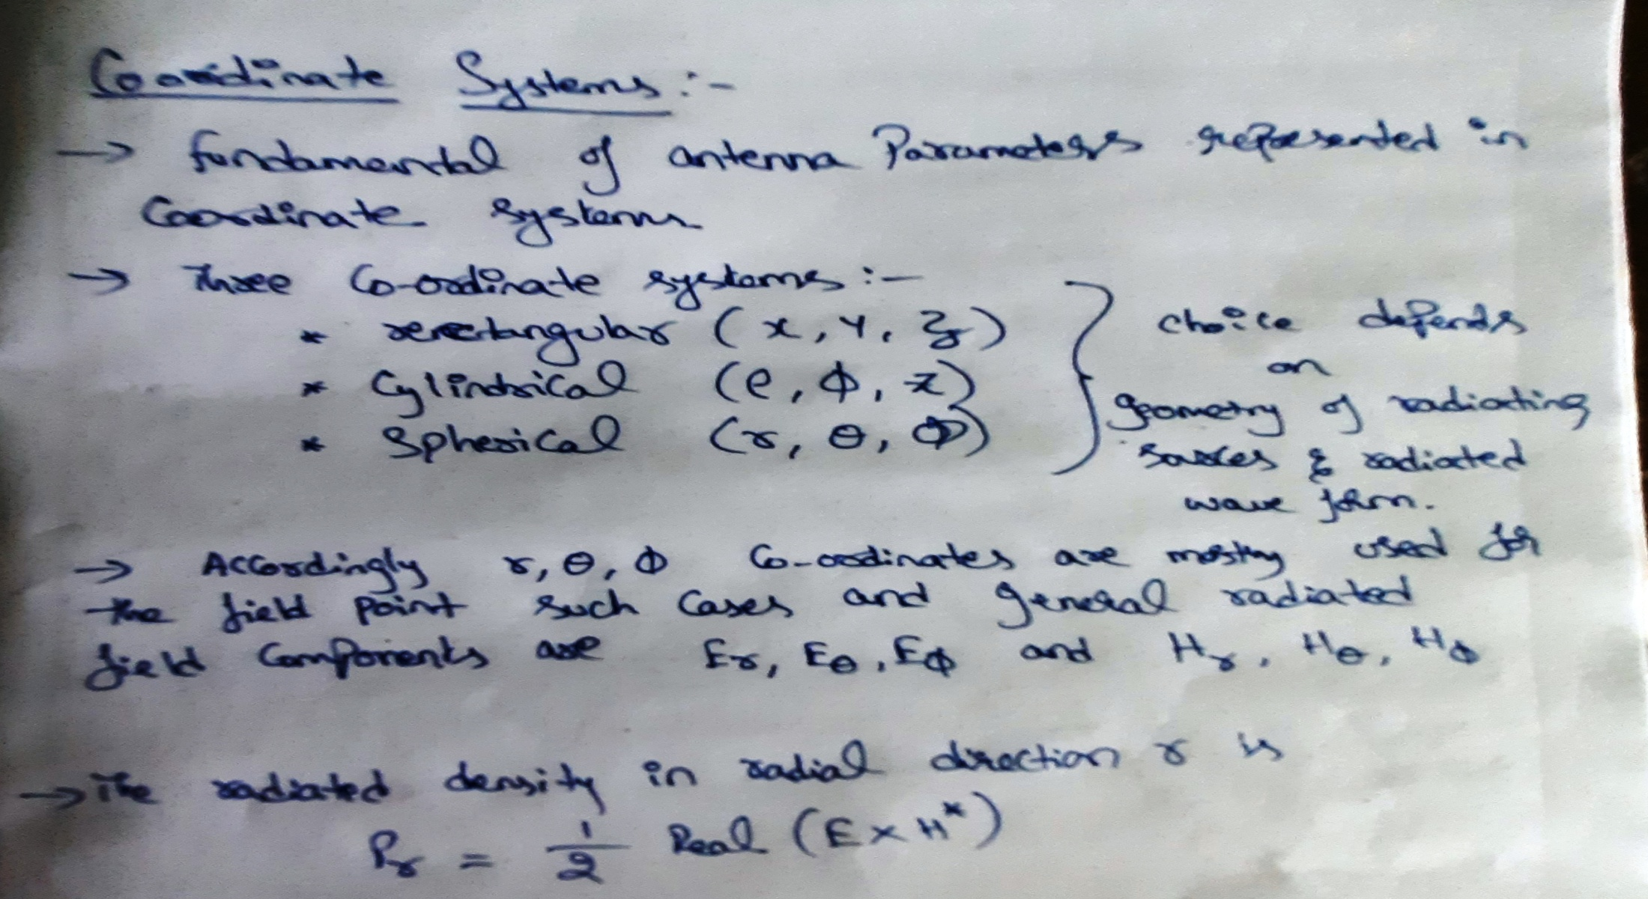
Basic Definitions of Antenna Analysis

Slide 27
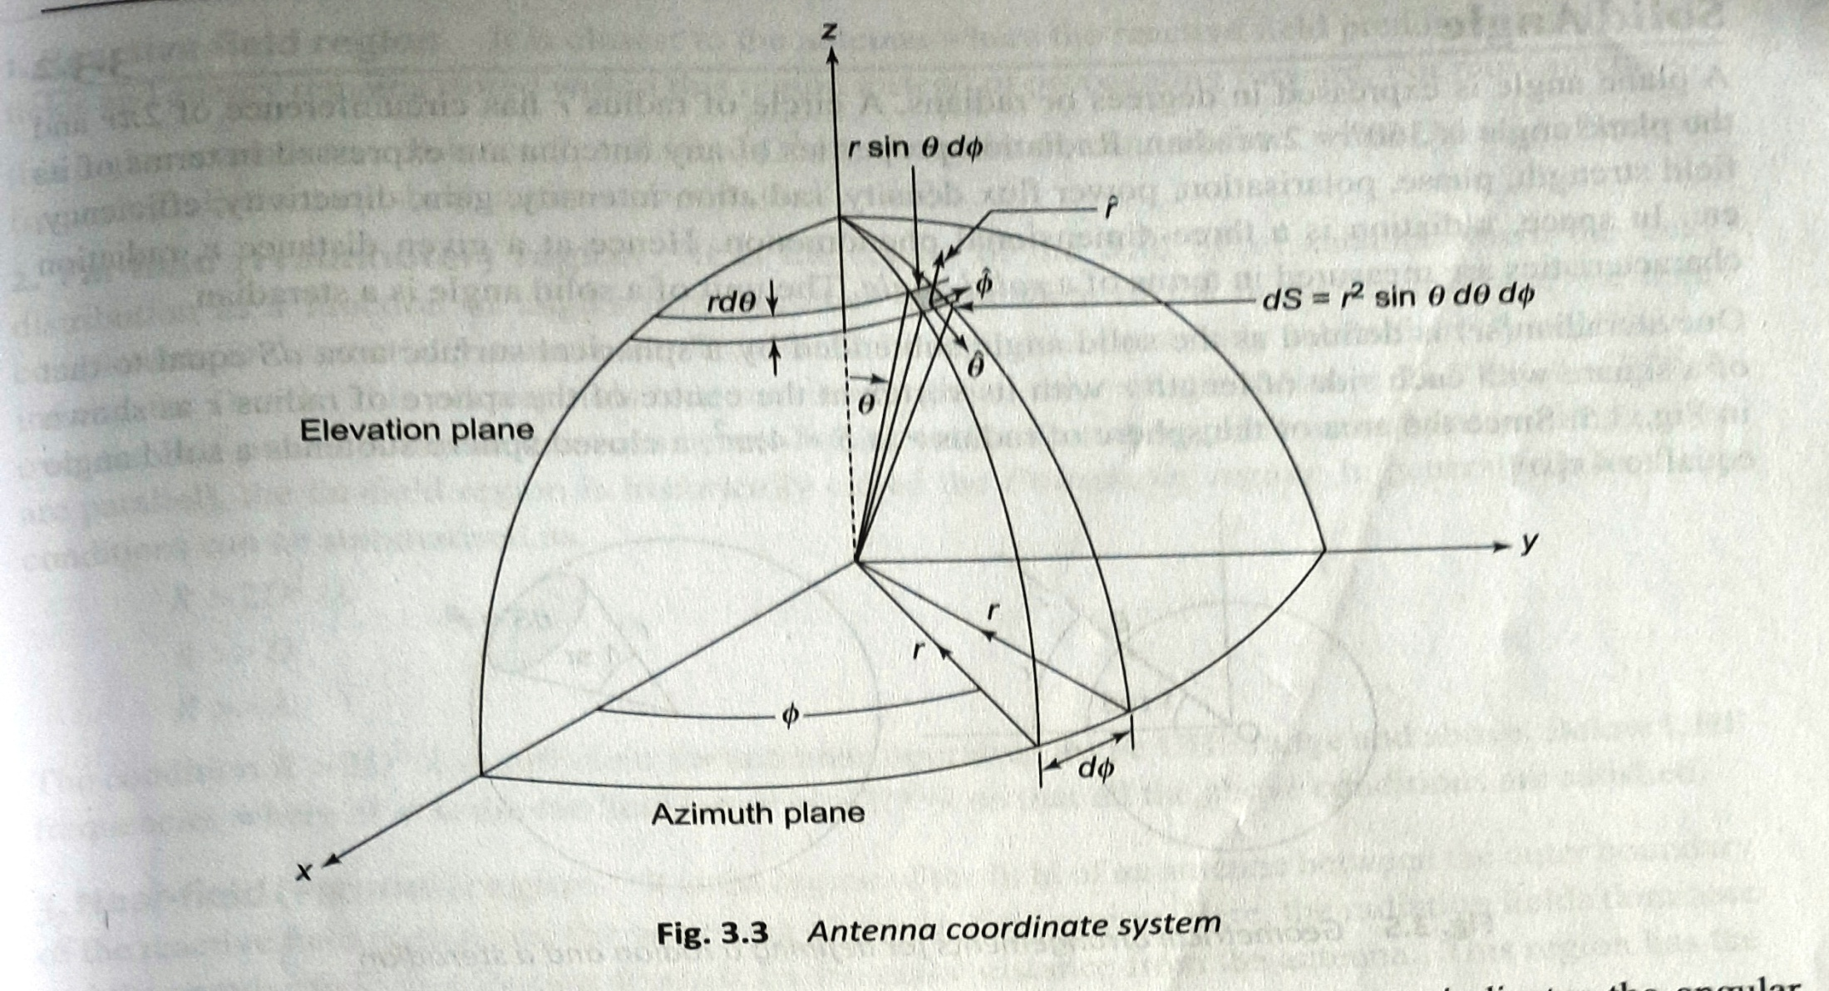

Slide 28
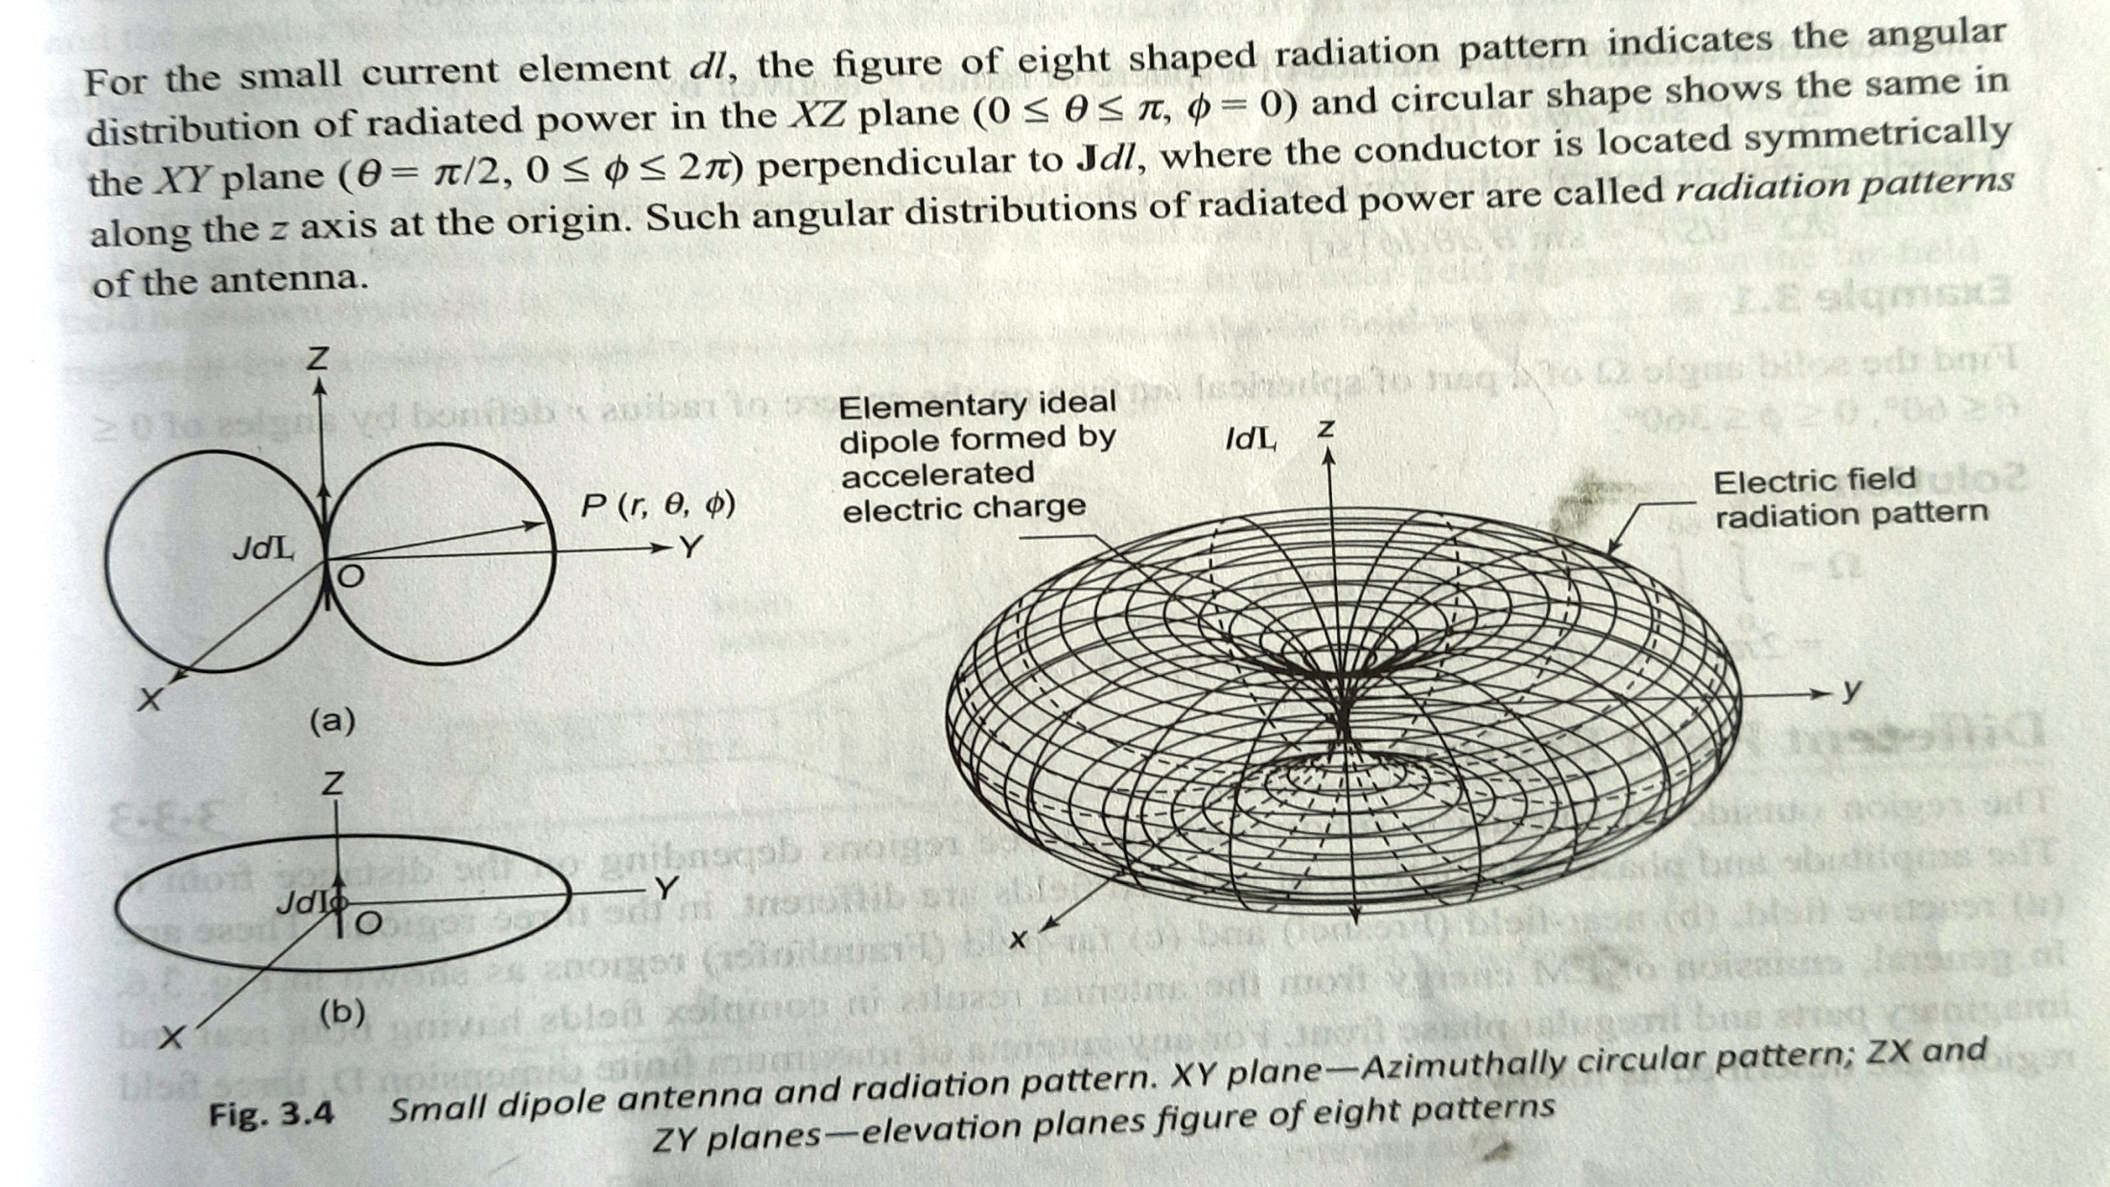

Slide 29
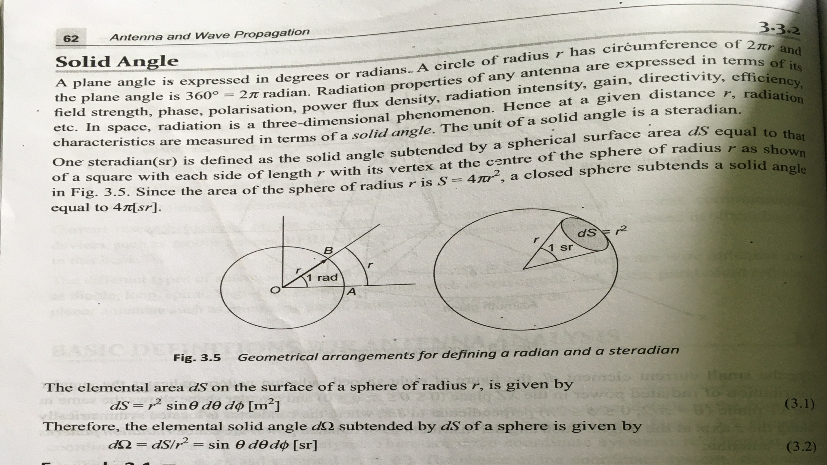

Slide 30
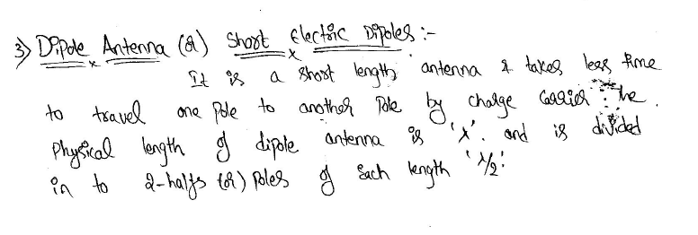
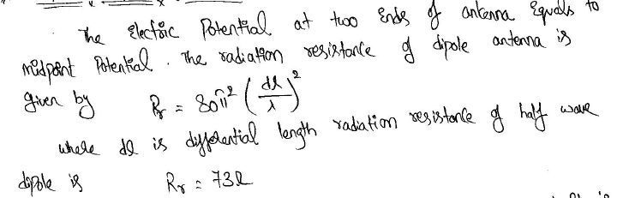

Slide 31
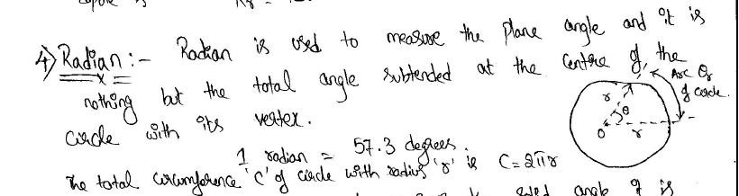

Slide 32
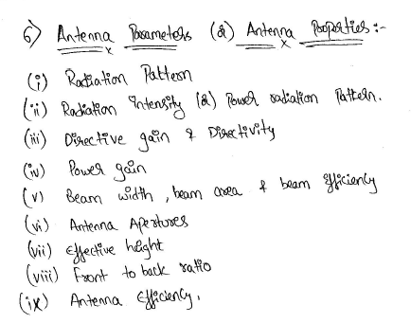

Slide 33
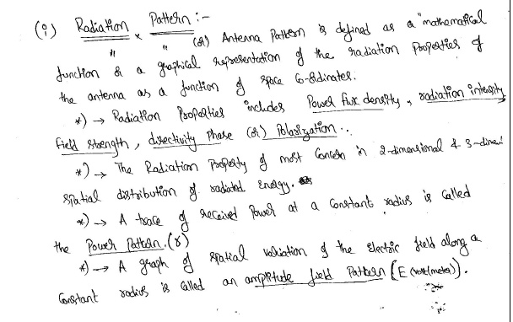

Slide 34
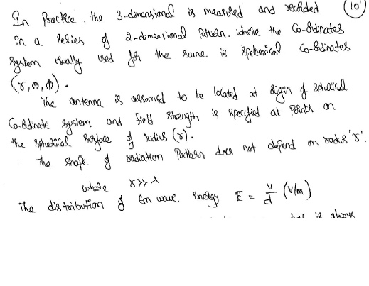

Slide 35
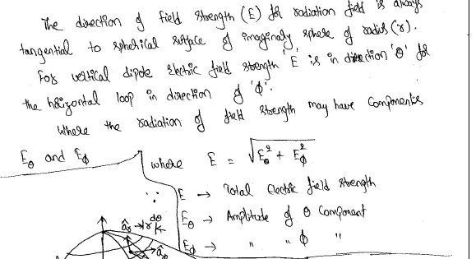
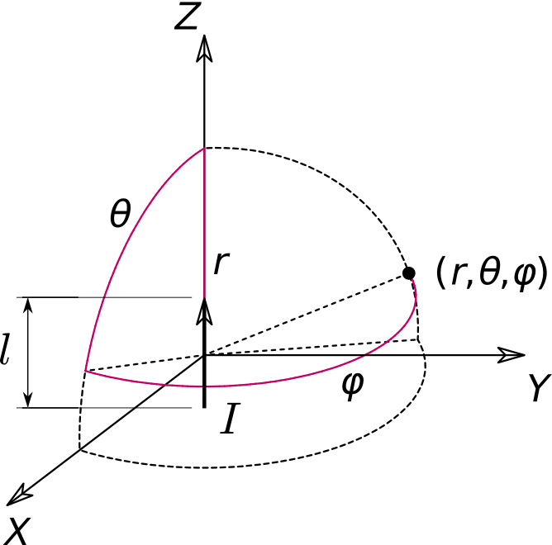

Slide 36
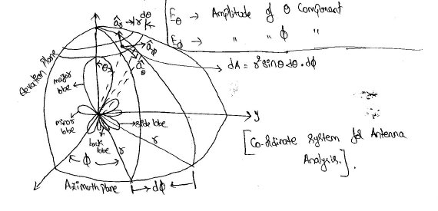

Slide 37
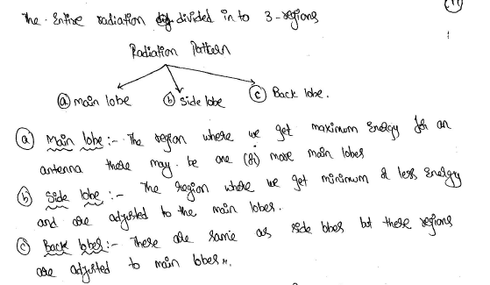

Slide 38
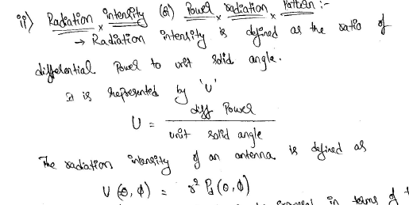

Slide 39
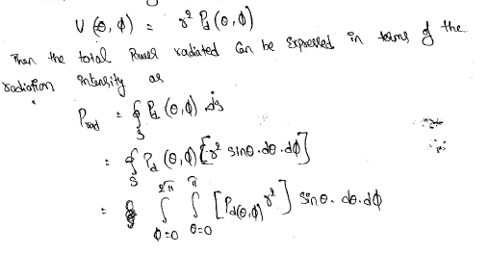

Slide 40
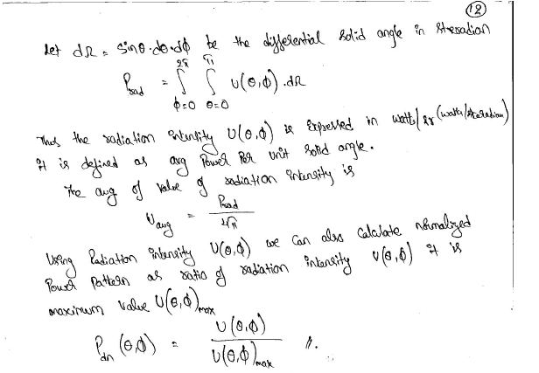

Slide 41
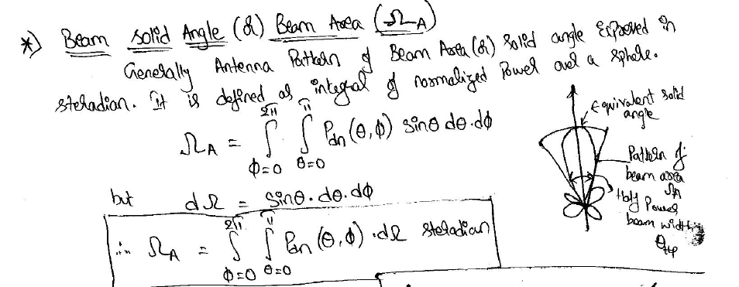
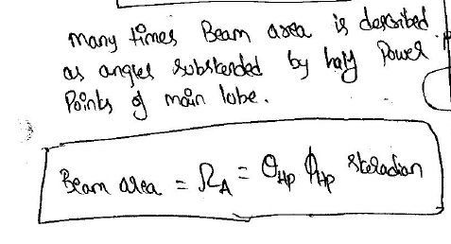

Slide 42
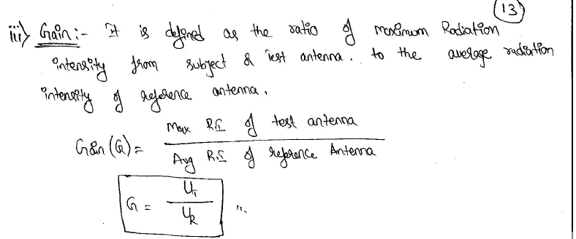

Slide 43
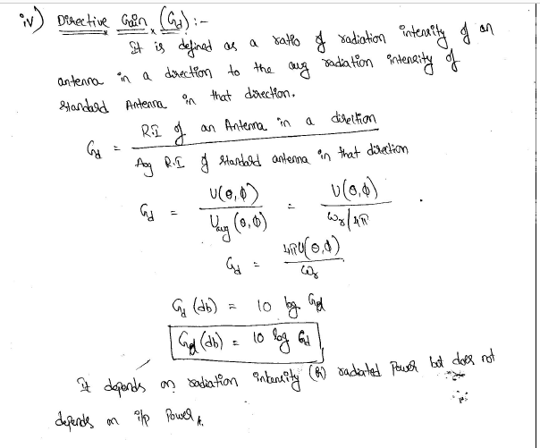

Slide 44
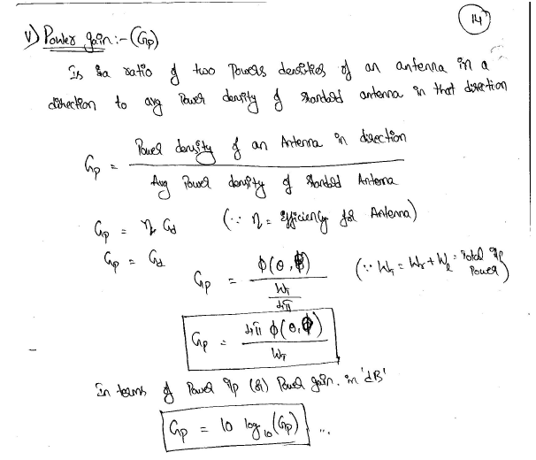

Slide 45
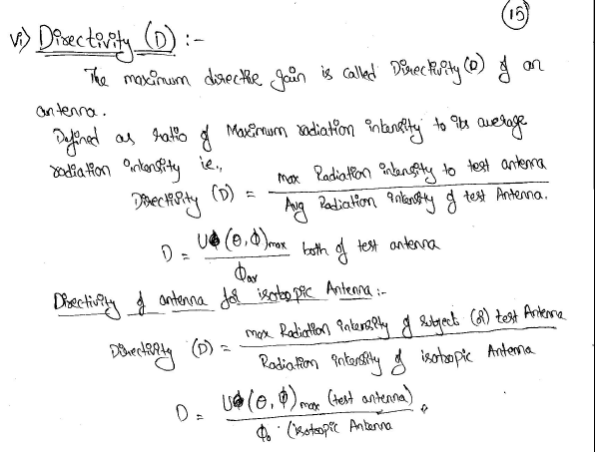

Slide 46
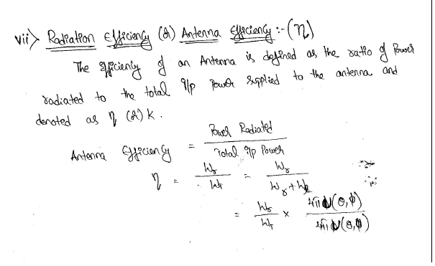

Slide 47
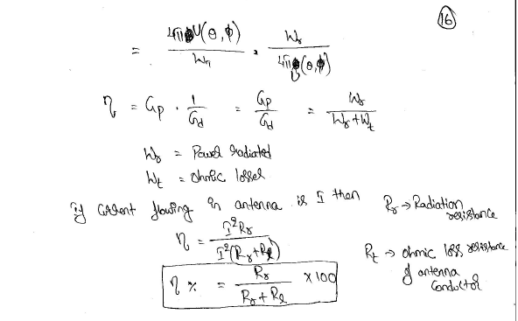

Slide 48
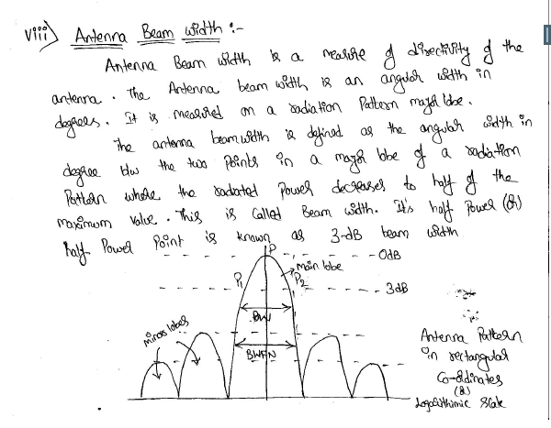

Slide 49


Slide 50


Slide 51


Slide 52


Slide 53


Slide 54


Slide 55


Slide 56


Slide 57

Patterns:
Radiation Resistance [Rr] and [TA] are simple scalar quantities.
where Radiation pattern is 3D quantities involving the variation of filed and power as a function of Spherical coordinates ϴ and ф and Filed pattern radius r.

Slide 58

Three Patterns
1. The component of electric field as a function of angles ϴ and ф or E ϴ (ϴ , ф)
2. The component of electric field as a function of angles ϴ and ф or E ф (ϴ ,ф )
3. The phases of these as a function of angles ϴ and ф (rad or deg).

Slide 59


Slide 60


Slide 61

Fields from Oscillating Dipole
Charge moving with uniform velocity along a straight conductor does not radiate, a charge moving back forth in simple harmonic motion along the conductor is subject to acceleration( and deceleration) and radiates.

Slide 62


Slide 63

Antenna Field Zones:
The fields around an antenna may be divided into two principal regions, one near the antenna called the near field or fresnel zone and one at a large distance called the far field or fraunhofer zone.
L= Maximum dimension of antenna, m

Slide 64


Slide 65


Slide 66


Slide 67


Slide 68


Slide 69


Slide 70


Slide 71


Slide 72


Slide 73


Slide 74


Slide 75


Slide 76


Slide 77


Slide 78


Slide 79


Slide 80


Slide 81


Slide 82


Slide 83


Slide 84


Slide 85


Slide 86
Applications :
An antenna has identical impedance when used for Tx and Rx purpose. This property is known as equality of impedances.
An antenna has identical directional characteristics or patterns when used for Tx and Rx purpose. This property is known as equality of directional patterns.
Antenna has the same effective length when used for Tx and Rx purpose it is known as equality of effective lengths.

Slide 87


Slide 88

The current and charge are related as :
dq/dt = I

Slide 89


Slide 90
attach-1.pdf
attach-2.pdf

Slide 91


